Slide 1
King County House Prices Prediction
By : Mustafa Al Hussain
SDAIA Bootcamp

Slide 2

Problem Statement
Determine and predict the housing prices of Seattle in U.S.A for new sellers and for buyers to estimate the profit of the deal

Slide 3
Dataset Description
date | price | bedrooms | bathrooms | sqft_living | sqft_lot | floors
20141013T000000 | 221900 | 3 | 1 | 1180 | 5650 | 1
20141209T000000 | 538000 | 3 | 2.25 | 2570 | 7242 | 2
20150225T000000 | 180000 | 2 | 1 | 770 | 10000 | 1
20141209T000000 | 604000 | 4 | 3 | 1960 | 5000 | 1
20150218T000000 | 510000 | 3 | 2 | 1680 | 8080 | 1
20140512T000000 | 1.23E+06 | 4 | 4.5 | 5420 | 101930 | 1
20140627T000000 | 257500 | 3 | 2.25 | 1715 | 6819 | 2
The dataset is taken from Kaggle. This dataset contains houses prices sold between May 2014 and May 2015.
It contains 21 Attributes and 21,600 instances.
Target Variable : Sales Price
Attributes like # bedrooms, # bathrooms , Area size , house condition and etc …

Slide 4
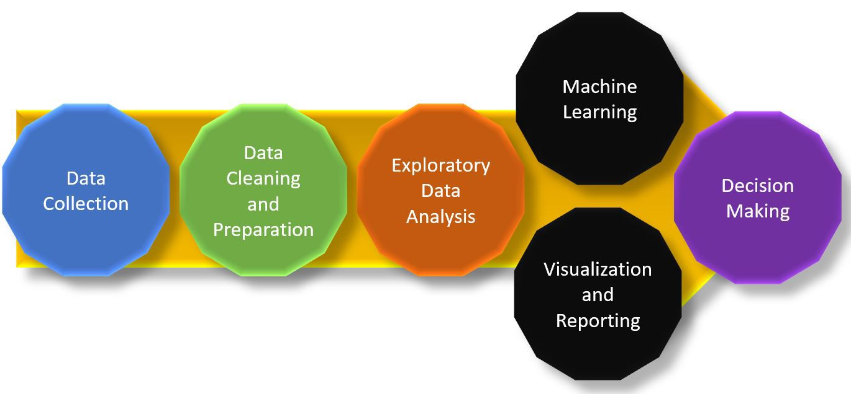
Methodology

Slide 5

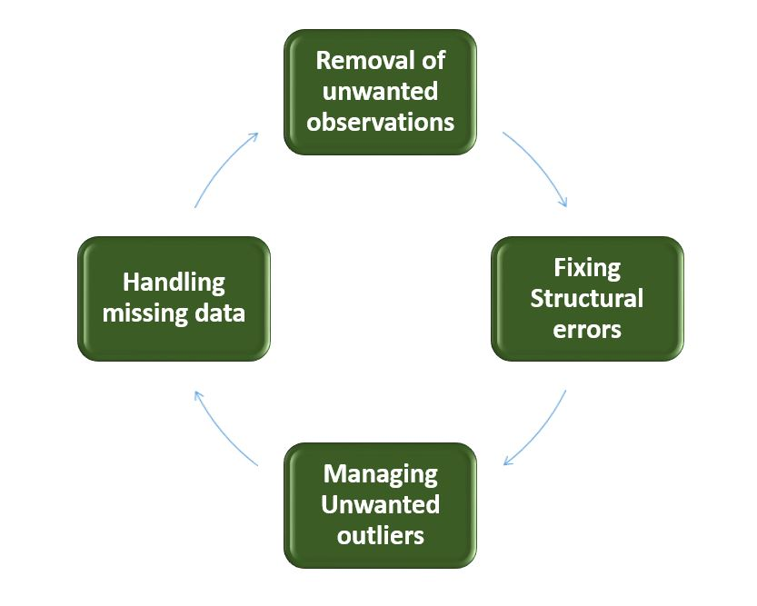
Data Cleaning

Slide 6

Feature Engineering

Slide 7

Web Scrapping with Bing API

Slide 8
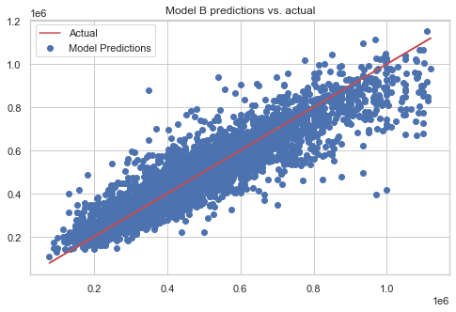
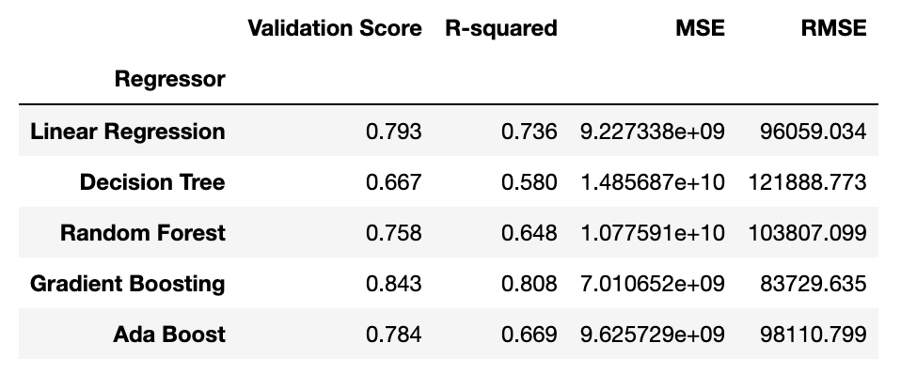
Training-Testing Models
Fine Tuning the Hyperparameters using Grid Search

Slide 9

Thank you!
Any Question

